Slide 1
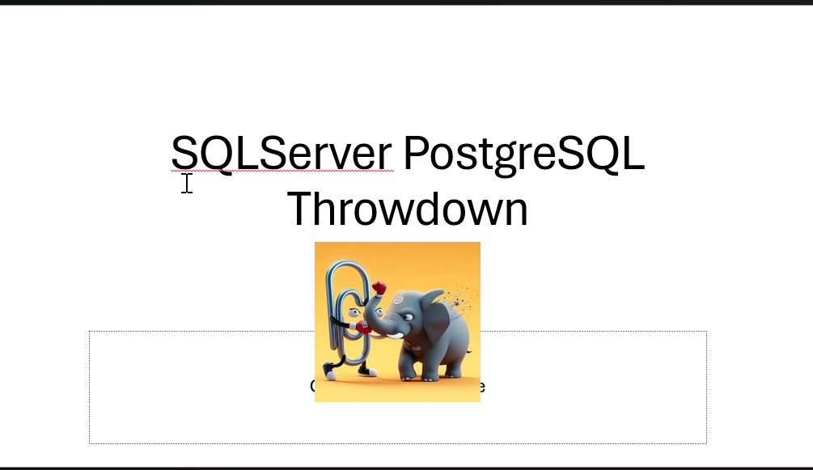

Slide 2

About Me
DBA for 26 Years SQL Server (since 6.5), POSTGRESQL AWS RDS and Stand Alone versions
Developer prior to being a DBA
Sr Database Administrator for The OCC.
CO-President Chicago Data Professionals Users Group

Slide 3
My Story
About four years ago maybe a little longer the company was developing some systems which involved AWS Aurora. I was asked to support it, and did.
The request shifted to straight PostgreSQL because of the need to be on prem as well as in the cloud.
Anyway always in the back of my mind was the decision as to why PostgreSQL. Why not SQL Server ?
Lets ask Database Administration said No C-Level Exec ever !!!
So hence this presentation of the SQL Server PostgreSQL Throwdown. Something on the order of the Bobby Flay Throwdown cooking shows.

Slide 4
History of PostgreSQL
The POSTGRES project, led by Professor Michael Stonebraker, was sponsored by the Defense Advanced Research Projects Agency (DARPA), the Army Research Office (ARO), the National Science Foundation (NSF), and ESL, Inc. The implementation of POSTGRES began in 1986.
The POSTGRES project, led by Professor Michael Stonebraker, was sponsored by the Defense Advanced Research Projects Agency (DARPA), the Army Research Office (ARO), the National Science Foundation (NSF), and ESL, Inc. The implementation of POSTGRES began in 1986.
The POSTGRES project, led by Professor Michael Stonebraker, was sponsored by the Defense Advanced Research Projects Agency (DARPA), the Army Research Office (ARO), the National Science Foundation (NSF), and ESL, Inc. The implementation of POSTGRES began in 1986.
Postgres was developed to address the limitations of its predecessor, Ingres. It aimed to better handle complex data types and relationships, and to Incorporate advanced features like object-oriente-data models and support for large databases
By 1996 POSTGRES Project stabilized and morphed into PostgreSQL as it’s known today.

Slide 5
History of SQL Server
The history of Microsoft SQL Server begins with the first Microsoft SQL Server product—SQL Server 1.0, a 16-bit server for the OS/2 operating system in 1989—and extends to the current day with SQL Server 2019, SQL Server 2022.

Slide 6
Costs
PostgreSQL: It’s an open-source database system, which means it’s freely available for use, modification, and distribution. The community actively contributes to its development.
SQL Server: Developed by Microsoft, SQL Server is a commercial product. Licensing fees apply, and it’s tightly integrated with other Microsoft technologies.

Slide 7
PostgreSQL is free but …
Yes the open source version is free.
But you have a support issue at 2:00 AM you will not get support from Free PostgreSQL.
Is that how you want your enterprise supported ?
So there are paid versions of PostgreSQL available. Which is what my company purchased.
It’s still slightly cheaper than SQL Server Enterprise License. A two-core pack of SQL Server Enterprise Edition now costs approximately $15,123. For the Enterprise Edition of EDB PostgreSQL , the cost approximately $13,748 for two cores

Slide 8

So this round PostgreSQL The winner !!!

Slide 9
PostgreSQL Uses MVCC Multiversion Concurrency Control
Allows multiple users to access the database simultaneously without risking data integrity or consistency.
Maintains data consistency by using a multiversion model.
Each transaction sees a snapshot of data as it was some time ago.
PostgreSQL keeps multiple versions of a data row, tagged with transaction IDs.
Provides a consistent view of the database at the start of each transaction.
Like Oprah Winfrey “Everybody gets a Copy !!!” Nobody gets locked out.

Slide 10
Well Big Deal !!! So Does SQLServer !!!
Had availability since SQL 2K5.
By default, SQL Server doesn’t use MVCC. However, it supports the Snapshot Isolation Level, which enables MVCC.
When you enable snapshot isolation, SQL Server maintains different versions of data rows.
This allows concurrent read and write operations with reduced lock contention and increased performance.

Slide 11
Sow How is this done in SQL Server ?
Run the following T-SQL statements (replace <DatabaseName> with your actual database name):
ALTER DATABASE <DatabaseName> SET ALLOW_SNAPSHOT_ISOLATION ON;
ALTER DATABASE <DatabaseName> SET READ_COMMITTED_SNAPSHOT ON;
ALLOW_SNAPSHOT_ISOLATION ON activates snapshot isolation.
READ_COMMITTED_SNAPSHOT ON replaces the default READ COMMITTED behavior with snapshot isolation.

Slide 12
Lab Snapshot Isolation SQL Server

Slide 13
So round 2 is a draw

Slide 14
PostgreSQL Data Types
bigint | int8 | signed eight-byte integer
bigserial | serial8 | autoincrementing eight-byte integer
bit [ (n) ] |  | fixed-length bit string
bit varying [ (n) ] | varbit [ (n) ] | variable-length bit string
boolean | bool | logical Boolean (true/false)
box |  | rectangular box on a plane
bytea |  | binary data (“byte array”)
character [ (n) ] | char [ (n) ] | fixed-length character string
character varying [ (n) ] | varchar [ (n) ] | variable-length character string
cidr |  | IPv4 or IPv6 network address
circle |  | circle on a plane
date |  | calendar date (year, month, day)
double precision | float8 | double precision floating-point number (8 bytes)
inet |  | IPv4 or IPv6 host address
integer | int, int4 | signed four-byte integer
interval [ fields ] [ (p) ] |  | time span
json |  | textual JSON data
jsonb |  | binary JSON data, decomposed
line |  | infinite line on a plane
lseg |  | line segment on a plane
macaddr8 |  | MAC (Media Access Control) address (EUI-64 format)
money |  | currency amount
numeric [ (p, s) ] | decimal [ (p, s) ] | exact numeric of selectable precision
path |  | geometric path on a plane
pg_lsn |  | PostgreSQL Log Sequence Number
pg_snapshot |  | user-level transaction ID snapshot
point |  | geometric point on a plane
polygon |  | closed geometric path on a plane
real | float4 | single precision floating-point number (4 bytes)
smallint | int2 | signed two-byte integer
smallserial | serial2 | autoincrementing two-byte integer
serial | serial4 | autoincrementing four-byte integer
text |  | variable-length character string
time [ (p) ] [ without time zone ] |  | time of day (no time zone)
time [ (p) ] with time zone | timetz | time of day, including time zone
timestamp [ (p) ] [ without time zone ] |  | date and time (no time zone)
timestamp [ (p) ] with time zone | timestamptz | date and time, including time zone
tsquery |  | text search query
tsvector |  | text search document
txid_snapshot |  | user-level transaction ID snapshot (deprecated; see pg_snapshot)
uuid |  | universally unique identifier
xml |  | XML data

Slide 15
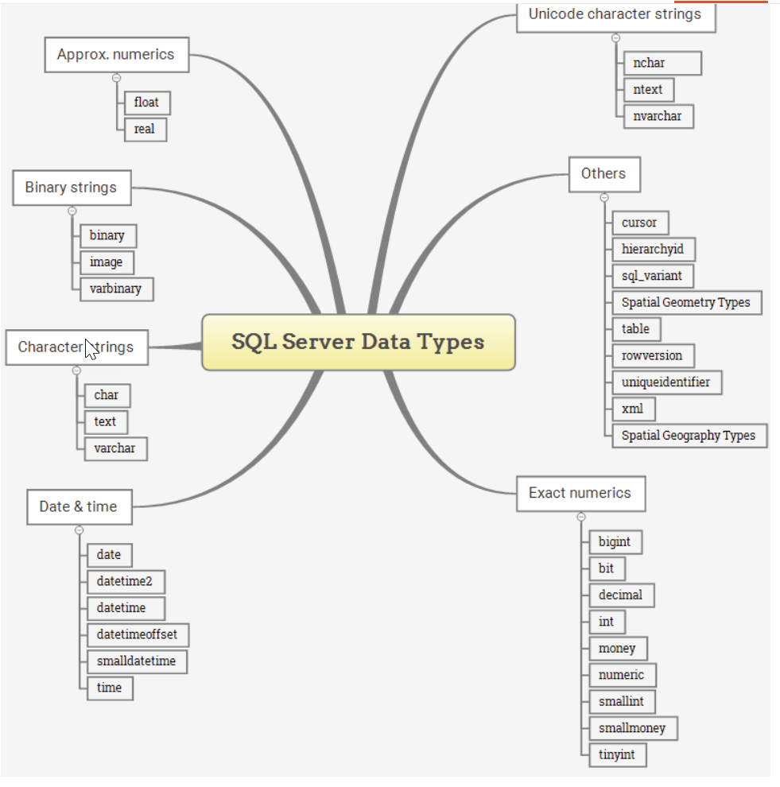
SQL Server Data Types

Slide 16
Round 3 PostgreSQL The winner !!!

Slide 17
Recovery PostgreSQL
Uses WAL (Write Ahead Log)
At all times, PostgreSQL maintains a Write-Ahead Log (WAL) in the pg_wal/ subdirectory of your database’s data directory.
The WAL records every change made to the database’s data files.
This log exists primarily for crash-safety purposes: if the system crashes, the database can be restored to consistency by replaying the log entries made since the last checkpoint.
The WAL is instance level so all databases in an instance are recovered using the WAL. Best practice dictates 1 database per instance.

Slide 18
Recovery PostgreSQL
Combine File System Backup with WAL Files
Combine File System Backup such as TAR with backup of the WAL Files
To do a recovery , restore the file system backup and the replay the backup WAL files to bring the system back to a current state.
To Recover to a specific point in time
Specify the desired stopping point (recovery target):
By date/time
Named restore point
Completion of a specific transaction ID
PostgreSQL will replay the WAL entries up to that point, giving you a consistent snapshot of the database as it was at that time.

Slide 19
PostgreSQL Recovery Benefits
pg_dump and pg_dumpall do not produce file-system-level backups suitable for continuous archiving. They are logical dumps and lack enough information for WAL replay.
You don’t need a perfectly consistent file system backup as the starting point. Log replay corrects any internal inconsistencies.
Continuous backup can be achieved by continuing to archive the WAL files.
You can restore the database to any point in time since your base backup was taken.
pg_dump and pg_dumpall do not produce file-system-level backups suitable for continuous archiving. They are logical dumps and lack enough information for WAL replay.

Slide 20
PostgreSQL Recovery Disadvantages
The biggest disadvantage is that recovery is complicated.
Recovery is done at the Instance Level. If Instance has three databases all three databases are recovered like it or not.
Recovery is Kluge.

Slide 21
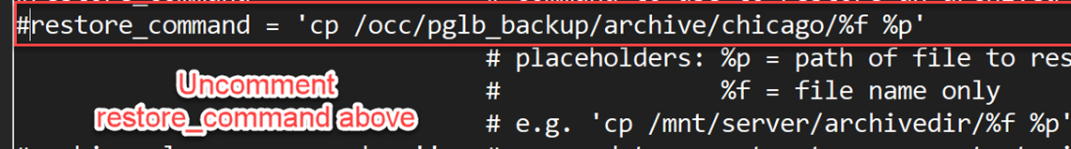
Recovery Example
cd /occ/pglb_backup/backups/basebkp_2024-09-26_10-04
rm -rf /occ/pglb_cluster/dallas/data/*
tar -xzvf base.tar.gz -C /occ/pglb_cluster/dallas/data
tar -xzvf pg_wal.tar.gz -C /occ/pglb_cluster/dallas/data/pg_wal
Change postgresql.conf :
Restart the Instance

Slide 22
SQL Server Recovery
Recovery is at the Database Level
Each Database has a self contained Log file
Like PostgreSQL you must have a full database backup as a starting point.
Recover database specify full backup and log files to point in time recovery.

Slide 23
SQL Server Recovery Benefit
Each Database is recoverable independent
No need to shut down the instance or the database as recovery can be done online.
Accelerated Data Recovery – Fast and consistent recovery regardless of the number of Transactions
File and Page Restore - SQL Server allows restoring specific files or pages instead of the entire database, which can reduce recovery time and keep other parts of the database online during the restore operation.

Slide 24
SQL Server Recovery Example
USE [master]
RESTORE DATABASE [MyDatabase2] FROM DISK = N'C:\Program Files\Microsoft SQL Server\MSSQL16.MSSQLSERVER\MSSQL\Backup\MyDatabase2_2024-1009.bak' WITH FILE = 1,
NOUNLOAD, STATS = 5
GO

Slide 25

Round 4 SQL Server scores a Knock out !!!

Slide 26
Questions ?
Contact –
Hrreed_2000@yahoo.com
Twitter @sqlservguy
BlueSky @sqlservguy.bsky.social

